Slide 1
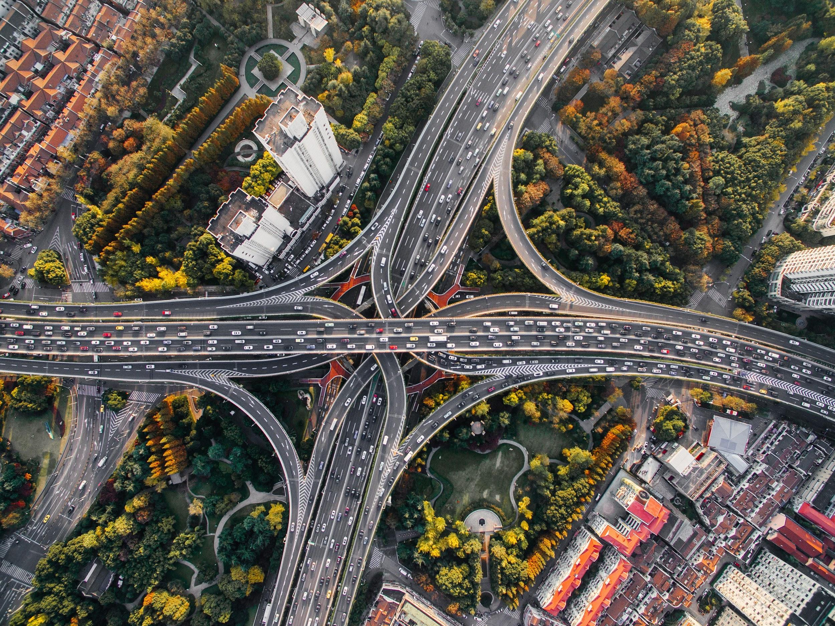
Investigating Car Accidents in Allegheny County, PA
Data Science and Big Data
Fall 2019
Team 8: Kanisk Mair and Brian McGrath

Slide 2
Key Findings
Car accidents follow a seasonal trend; the number of accidents and causes of accidents vary from month to month.
The number of accidents and causes of accidents also vary by day and time.
Road conditions and illumination contribute to accidents.
Aggressive driving and impaired driving contribute to accidents.

Slide 3
Overview of Data
Dataset: “Allegheny County Crash Data”
Publisher: Allegheny County/City of Pittsburgh/Western PA Data Center
Contains data about every car crash in Allegheny County reported to police between 2004 - 2017
Format: CSV file containing records on 182,783 crashes in Allegheny County
Available online at: https://catalog.data.gov/dataset/allegheny-county-crash-data

Slide 4
Themes discovered in the data
We discovered that the story told by the data centers around three key themes:
Accident Facts
How are the basic facts about the accident distributed?
Environmental Variables
How are environmental factors influencing accidents distributed?
Driver Behavior
How are driver behaviors influencing accidents distributed?

Slide 5

Theme 1: Accident Facts
Date and time of the accident
Type of vehicles involved
Physical objects struck during accident (trees, guardrails, etc.)

Slide 6
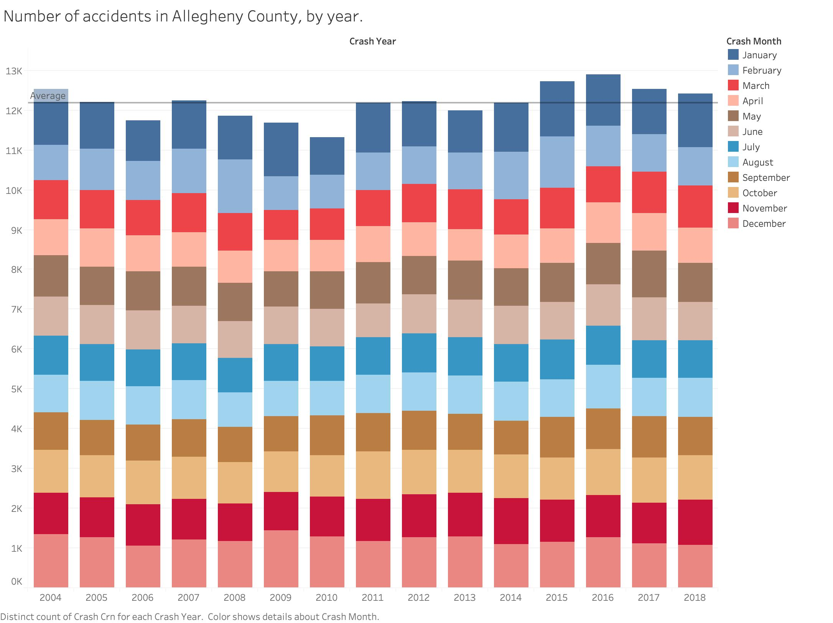
Theme 1: Accident Facts: Date and Time
Key Finding:
The number of accidents in Allegheny County is relatively stable from year to year.

Slide 7
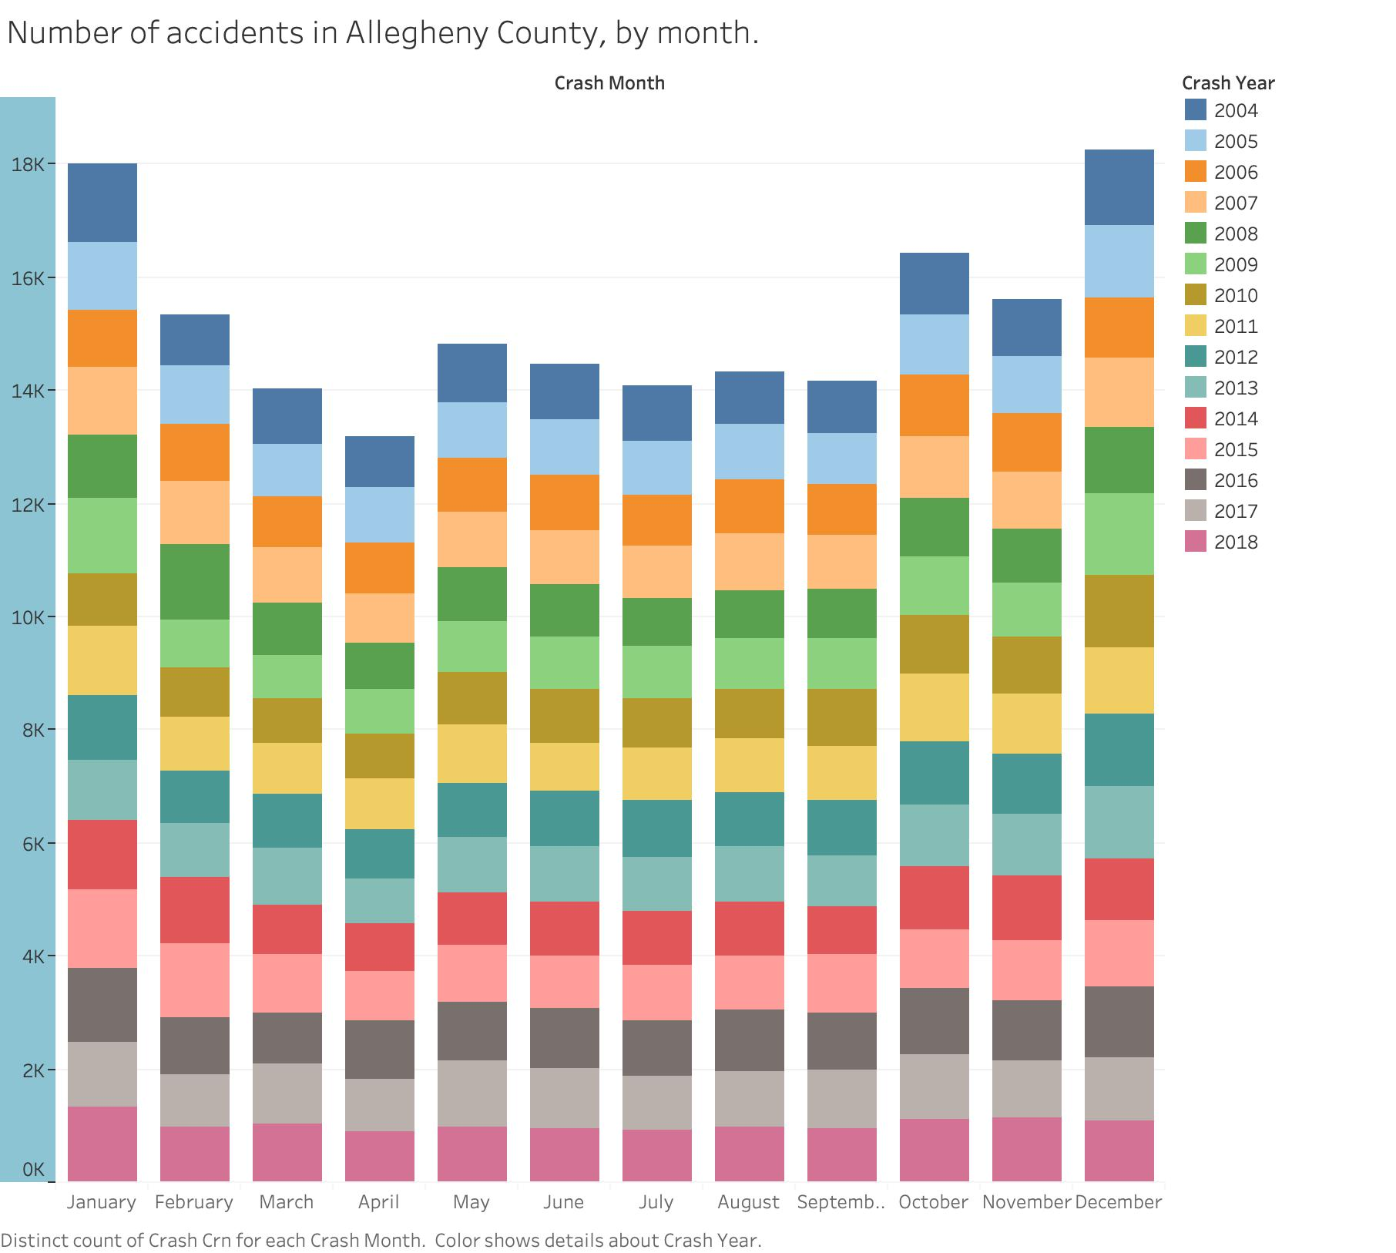
Theme 1: Accident Facts: Date and Time
Key Finding:
The number of accidents in Allegheny County varies from month to month.
We believe there is a seasonal trend in the accident variance from month to month, and use this hypothesis to inform many of our visualizations.

Slide 8
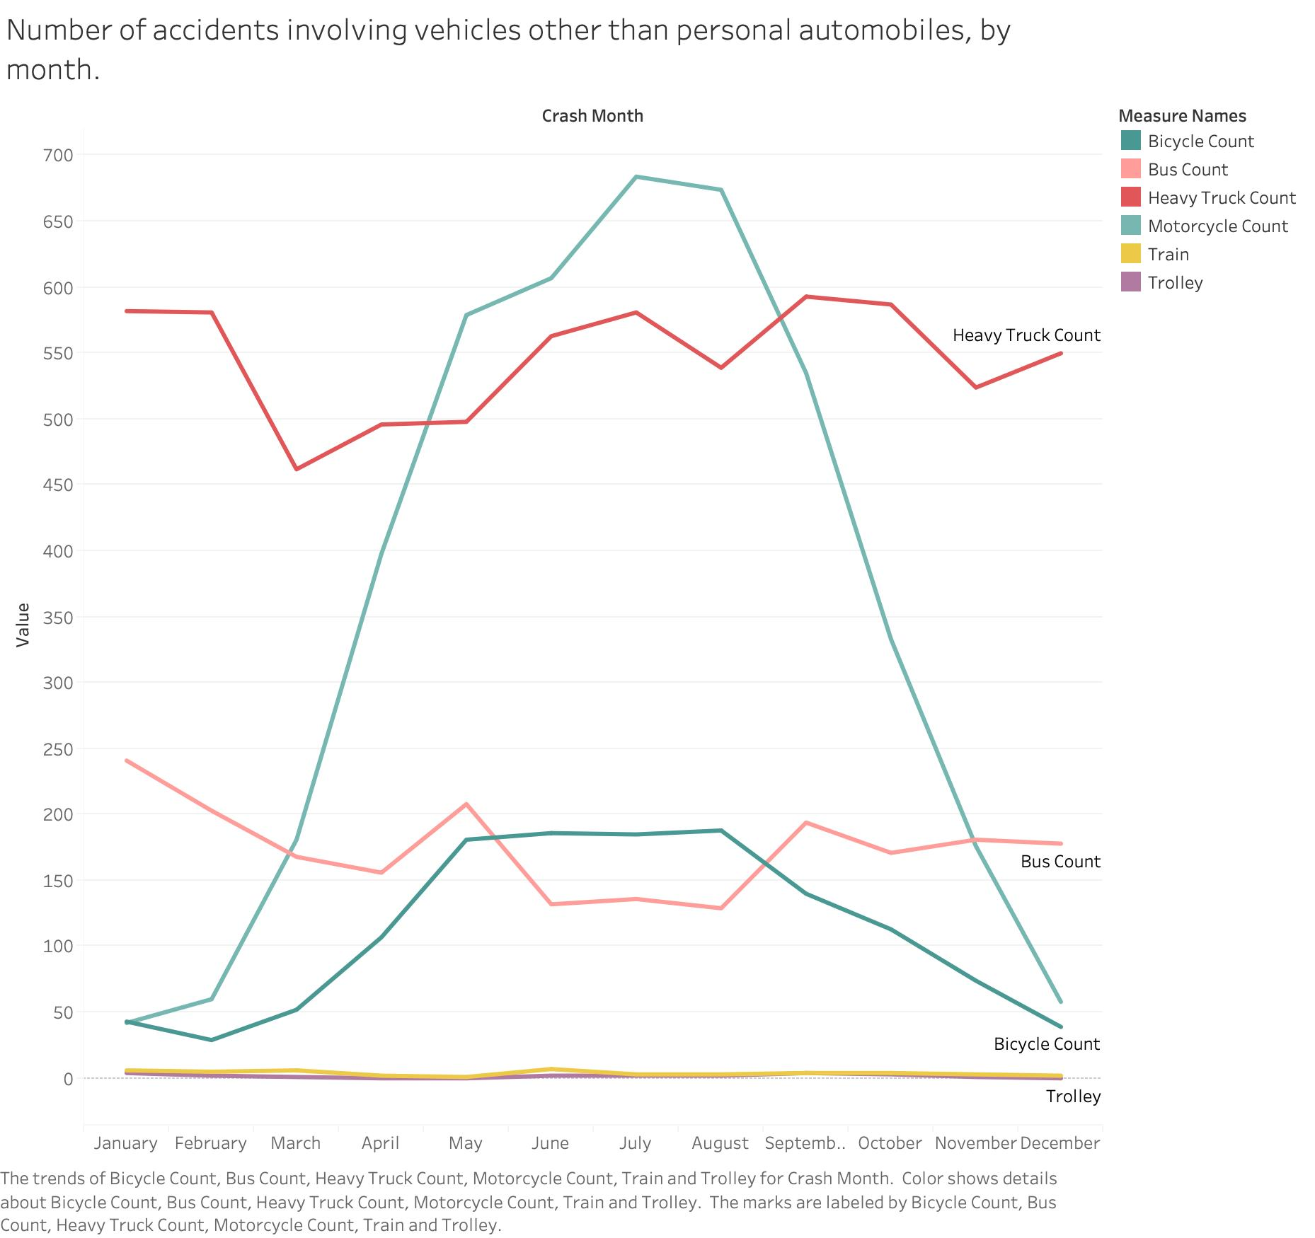
Theme 1: Accident Facts: Vehicles Involved
Key Finding:
The type of vehicles (other than personal automobiles) involved in accidents vary from month to month for certain types of vehicles.
Motorcycle and bicycle accidents peak during the summer months.
Bus accidents decrease during the summer months.

Slide 9
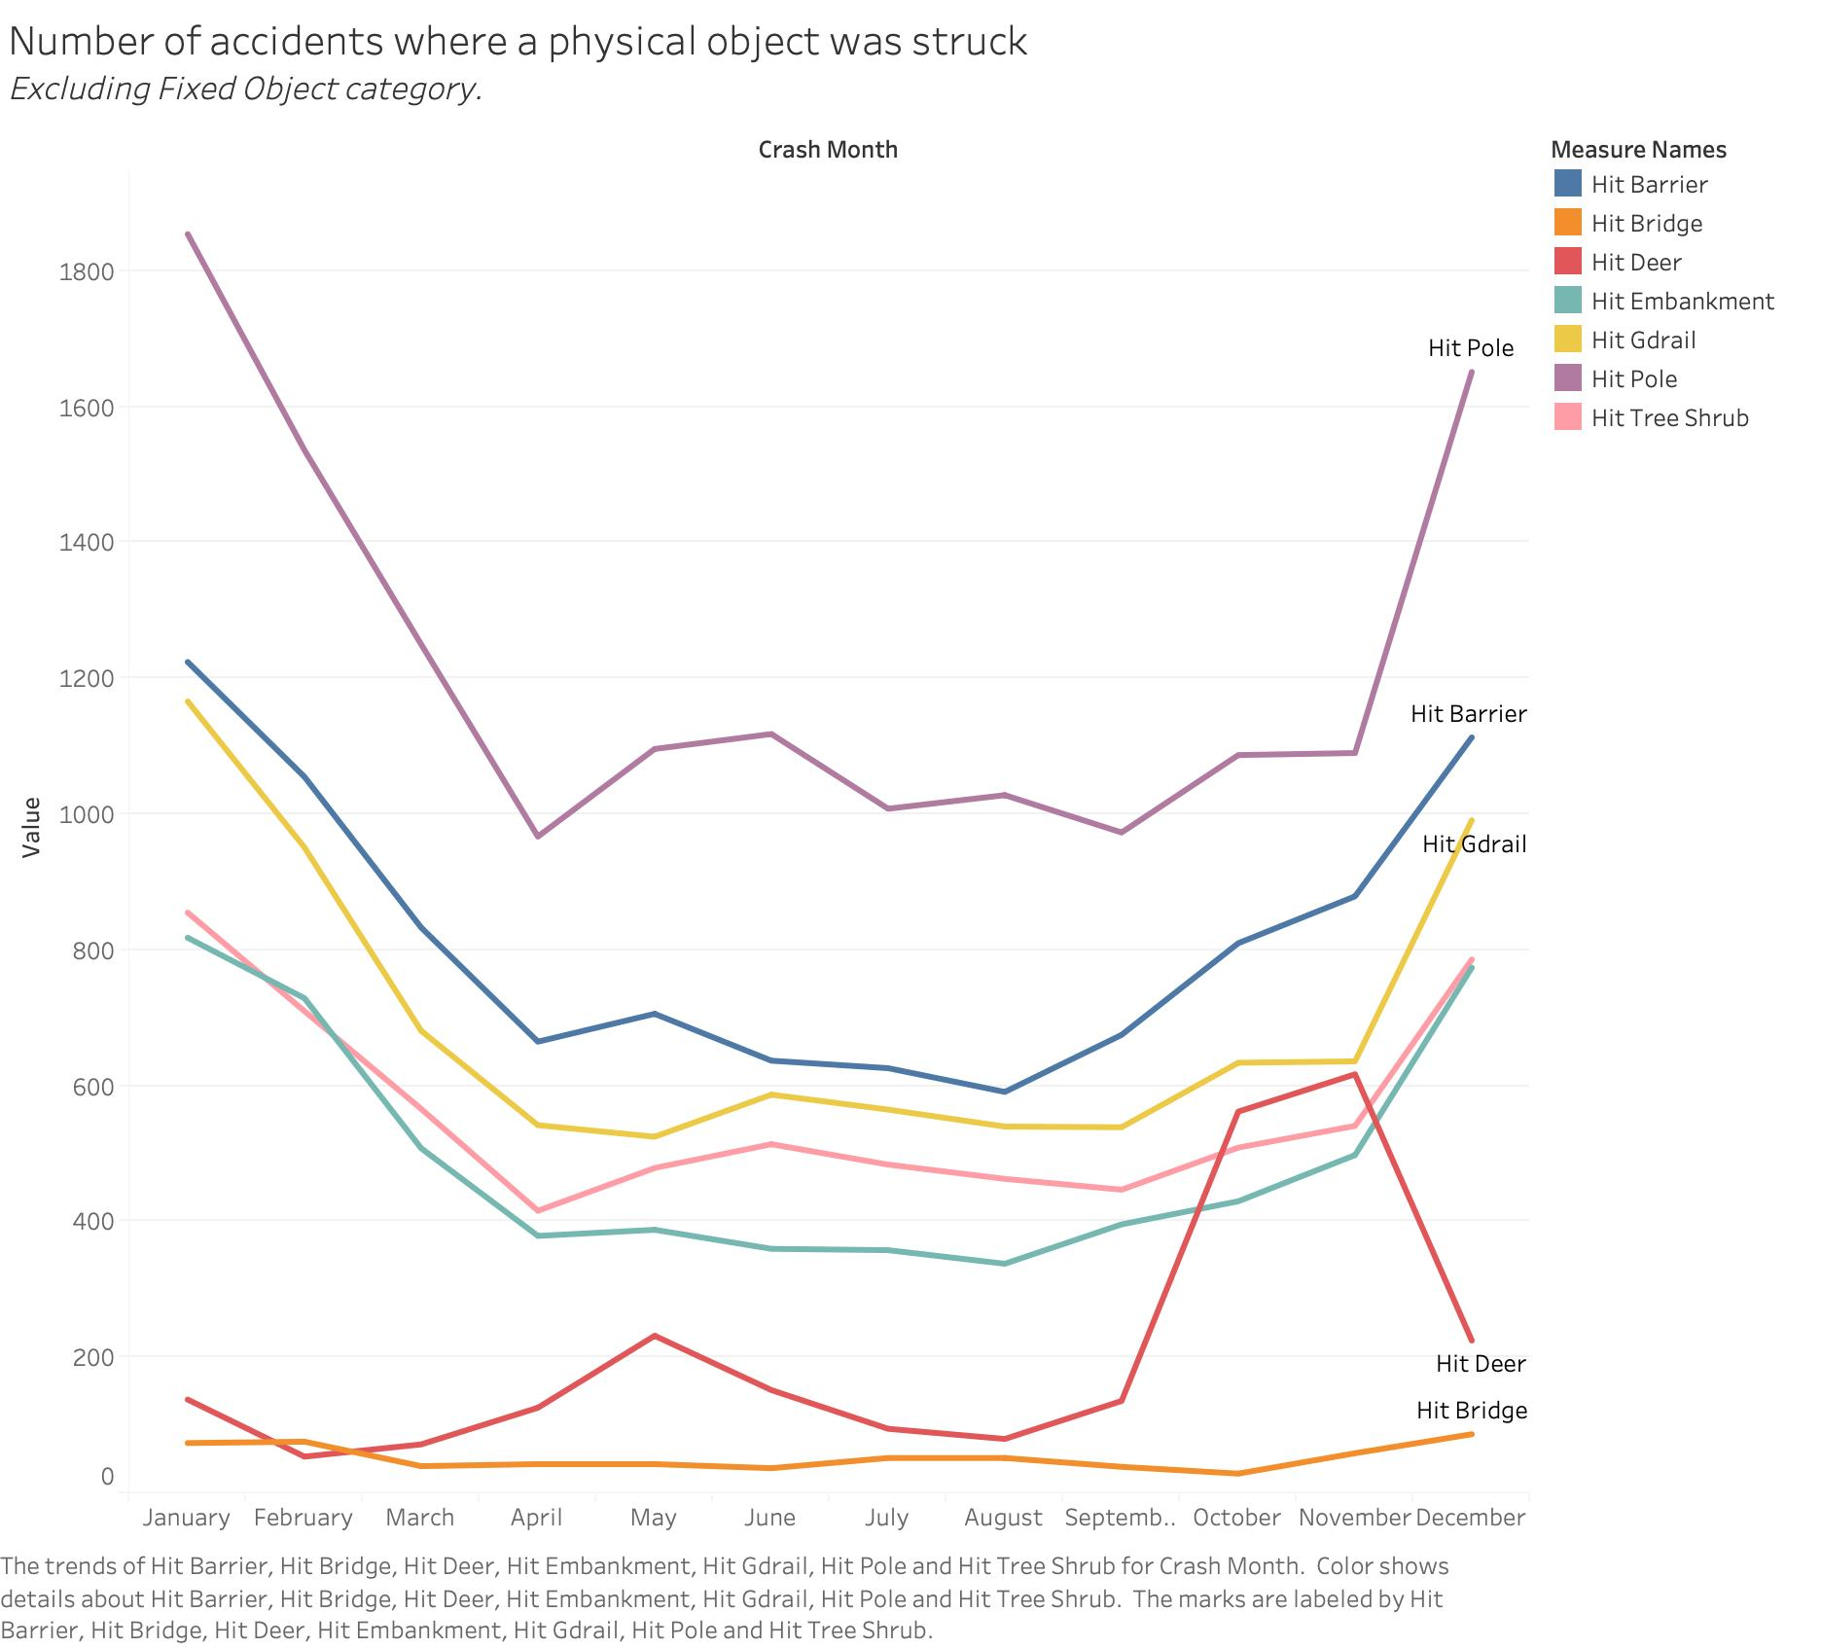
Theme 1: Accident Facts: Physical Objects
Key Finding:
For most cases where a physical object was struck during the accident, we observe a seasonal trend; these accidents occur mostly during the winter months.
One notable exception are cases where the driver hit a deer; these cases peak during the fall months.

Slide 10
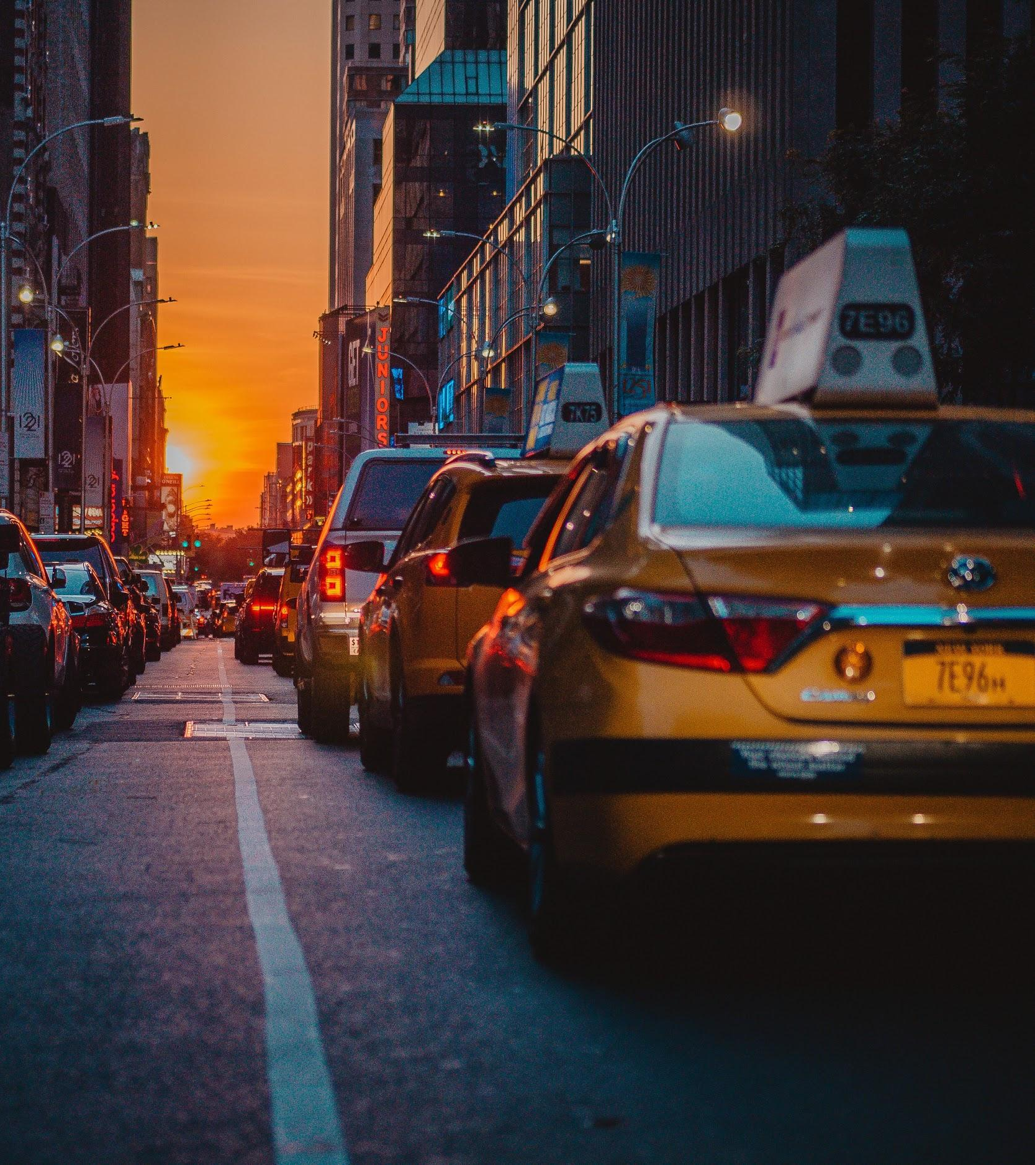
Theme 2: Environmental Variables
Weather conditions
Road type and condition
Occurrence within school zones

Slide 11
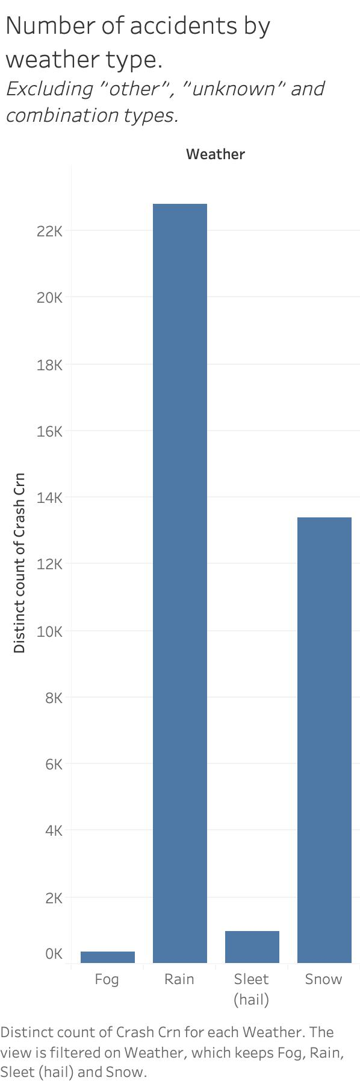
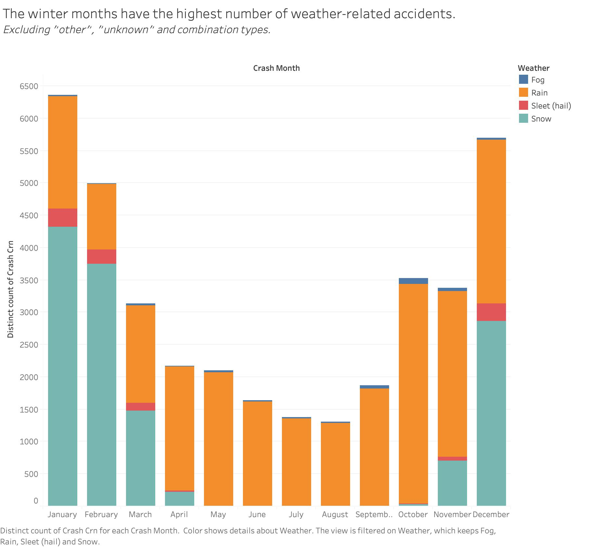
Theme 2: Environmental Variables: Weather
Key Finding:
Among accidents where weather is a factor, rain is by far the main type of weather related to accidents.
At a closer look, this appears to be due to rain occurring during all 12 months, while snow only appears during 7 months.

Slide 12
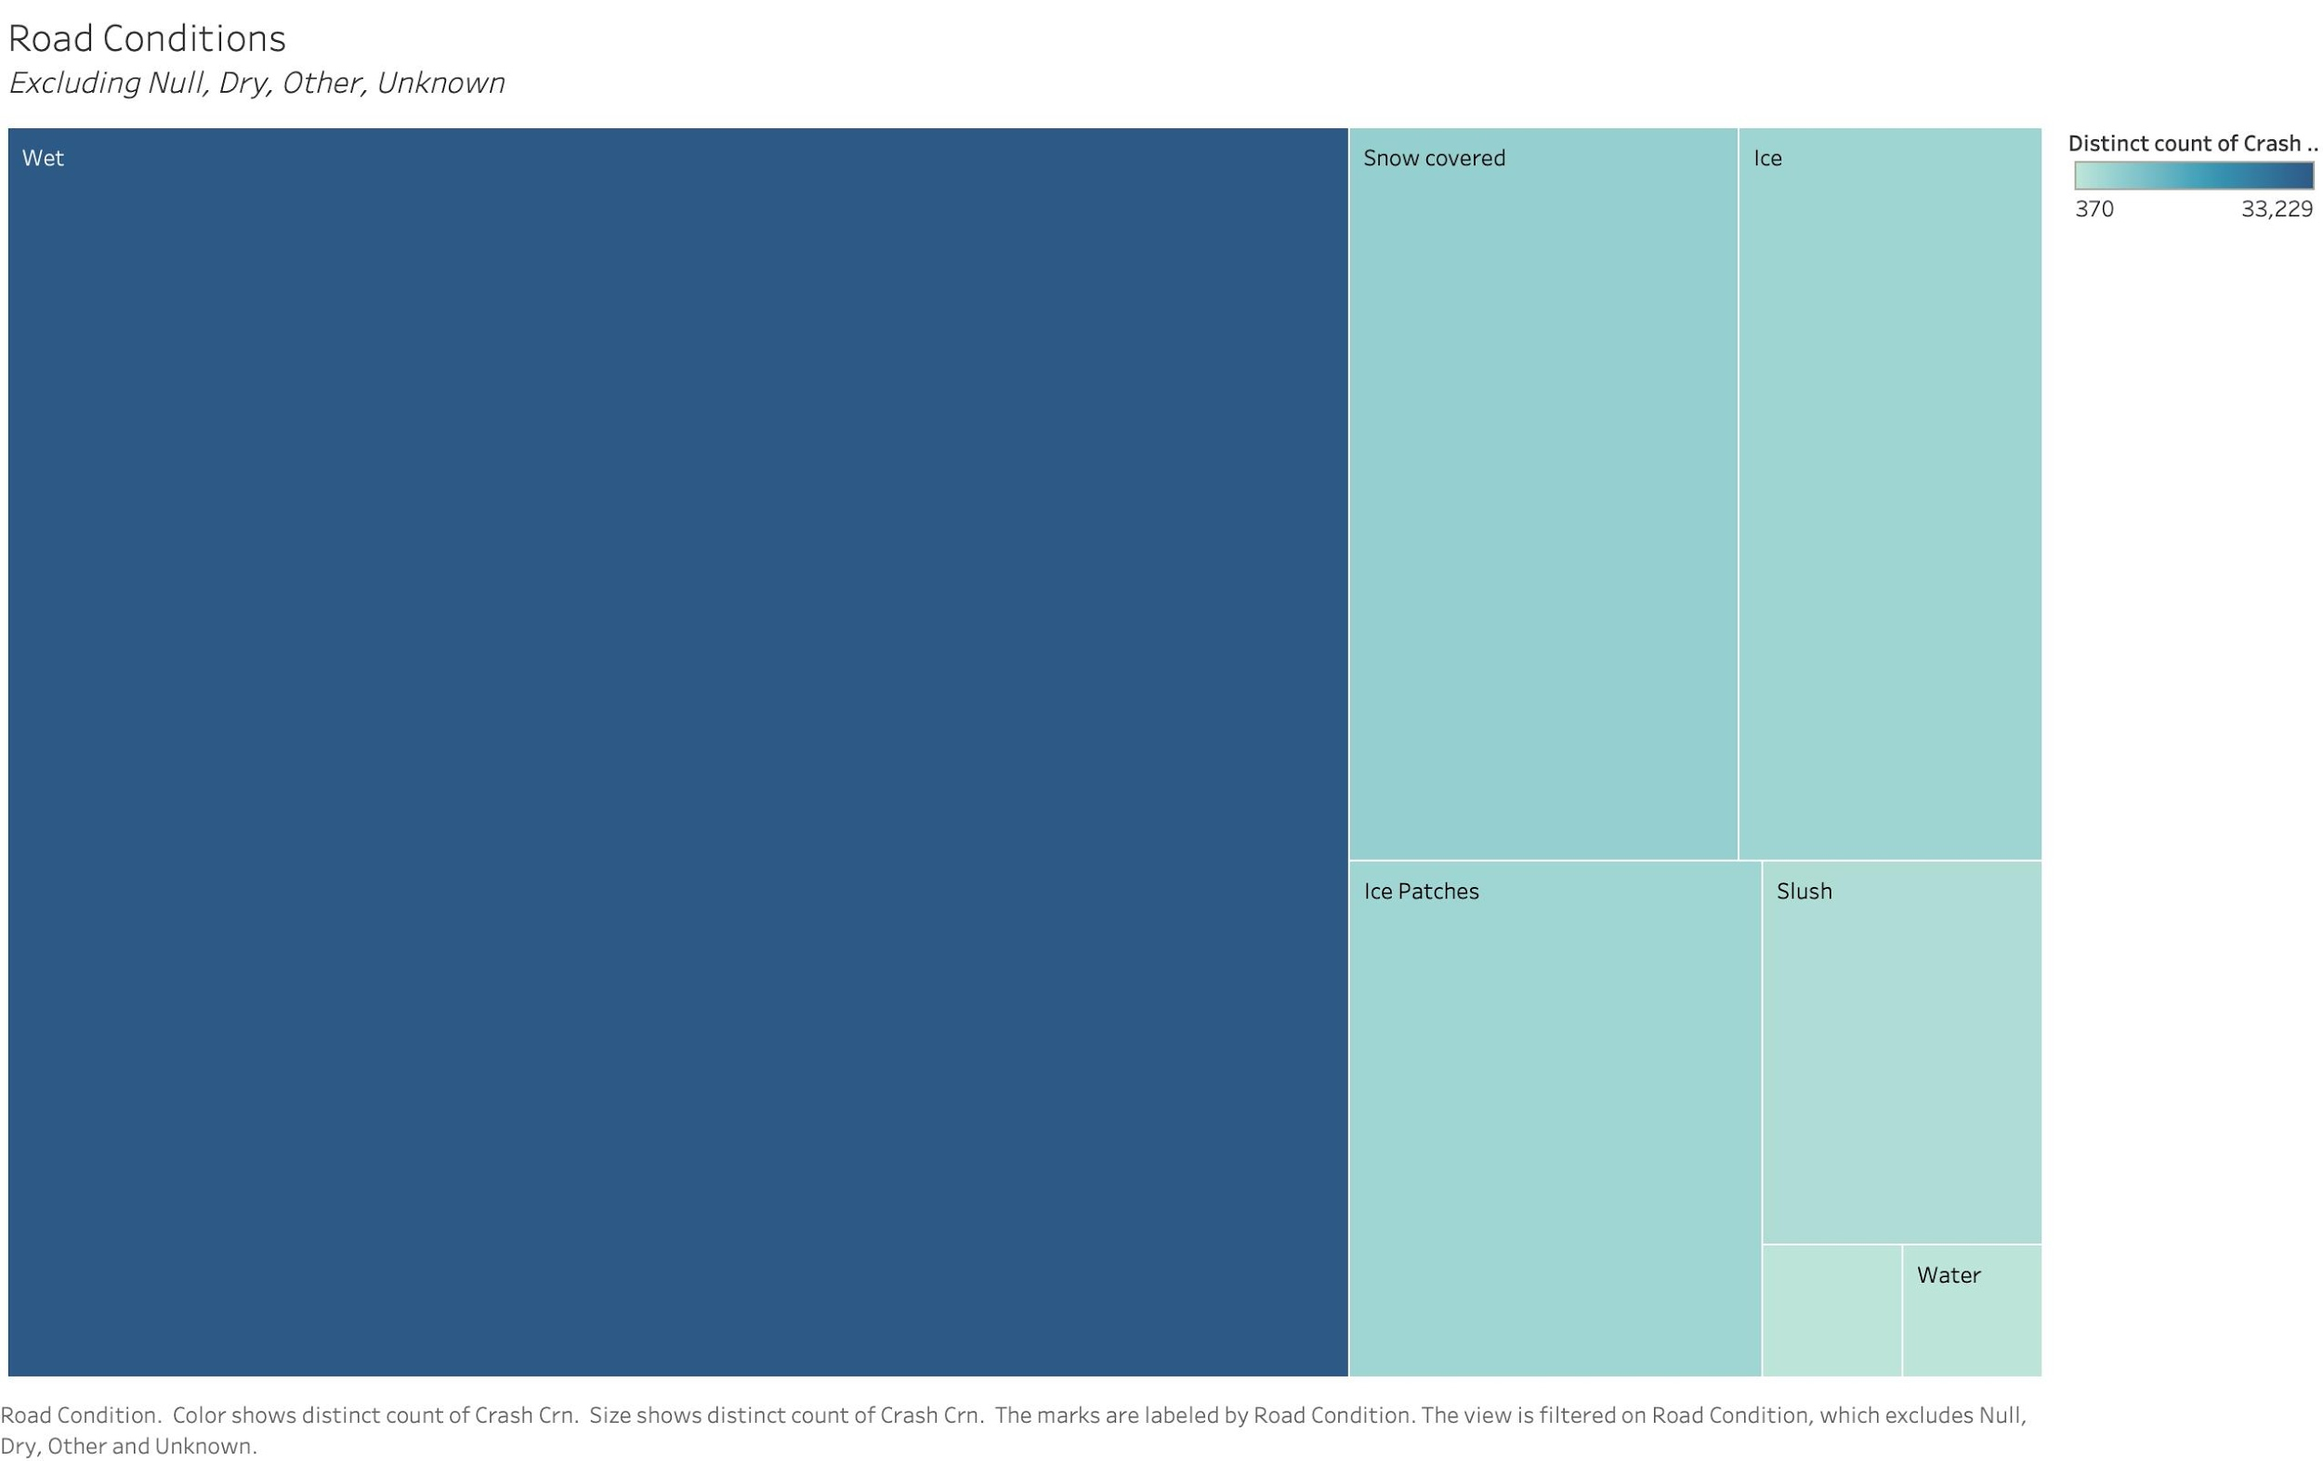
Theme 2: Environmental Variables: Road Conditions
Key Finding:
The road conditions related to accidents support our findings that rain is the primary weather type related to accidents.

Slide 13
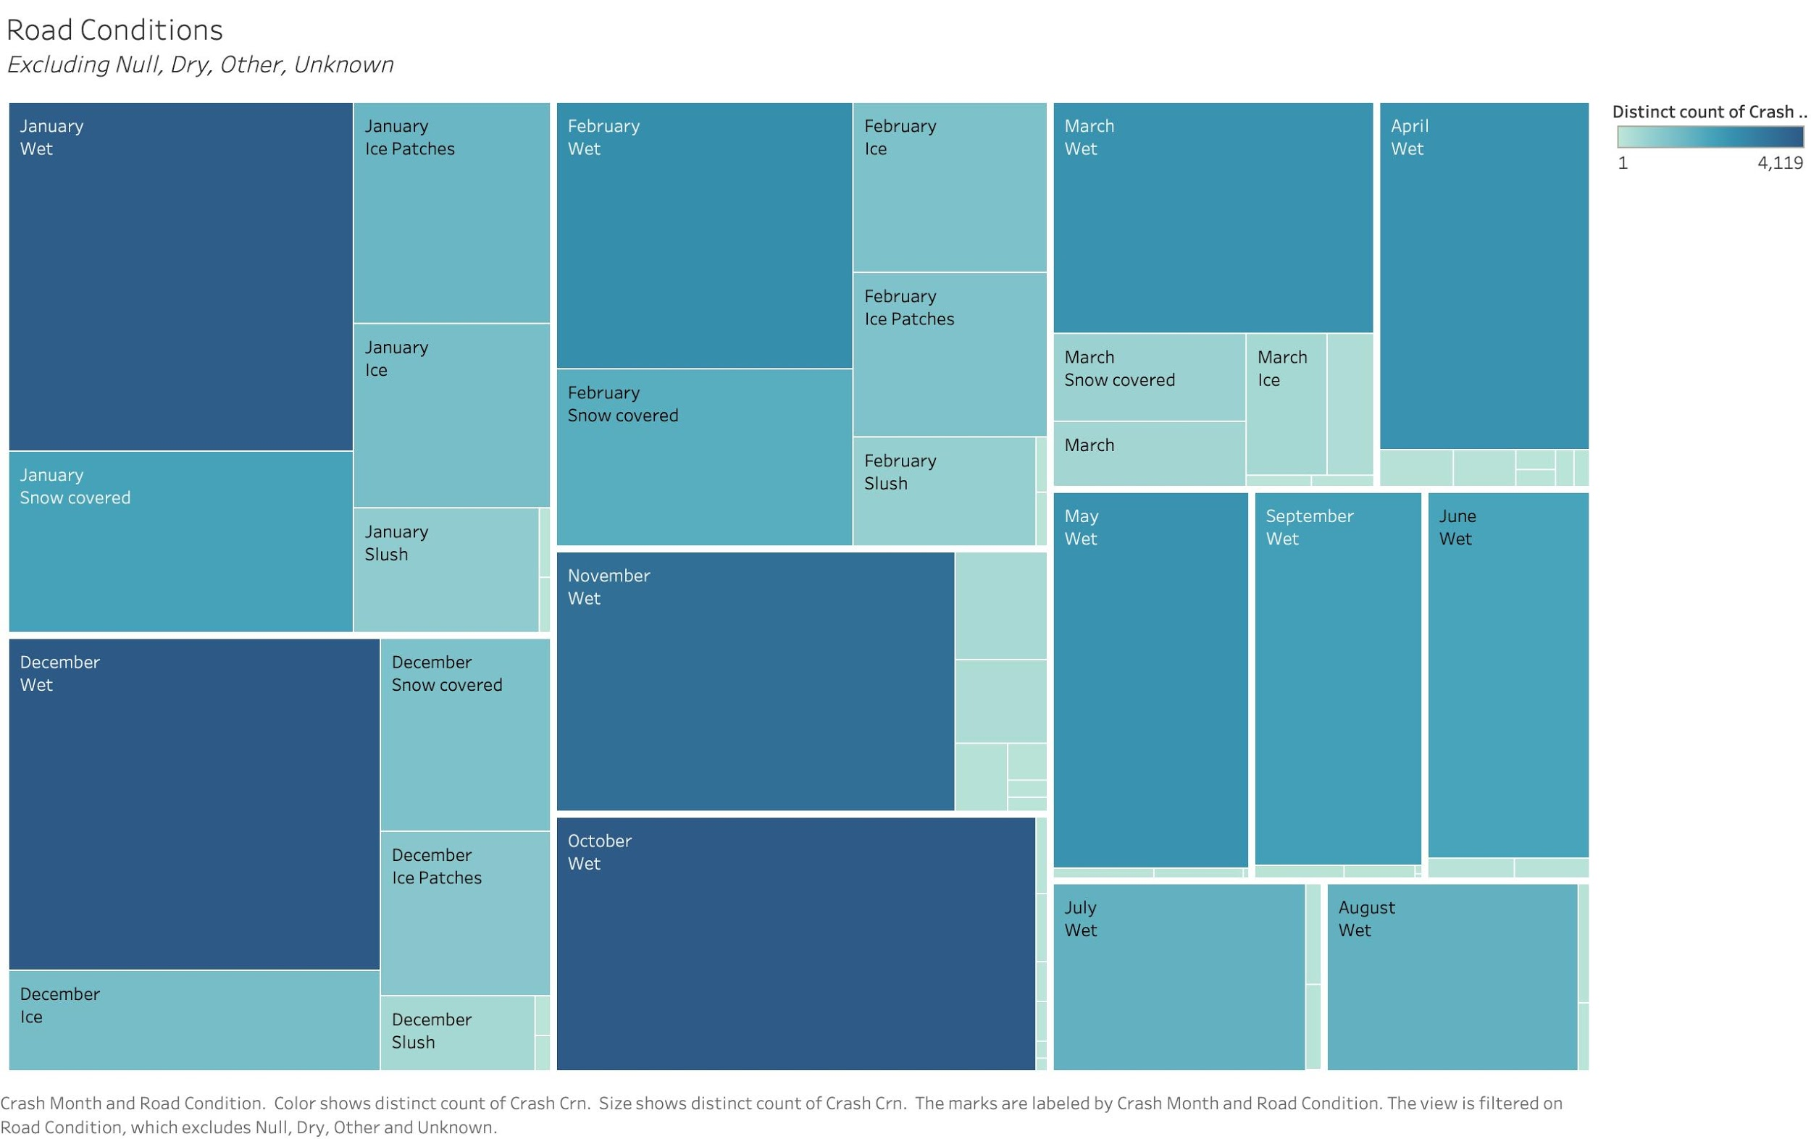
Theme 2: Environmental Variables: Road Conditions
Key Finding:
The distribution of road conditions related to accidents varies from month to month.

Slide 14
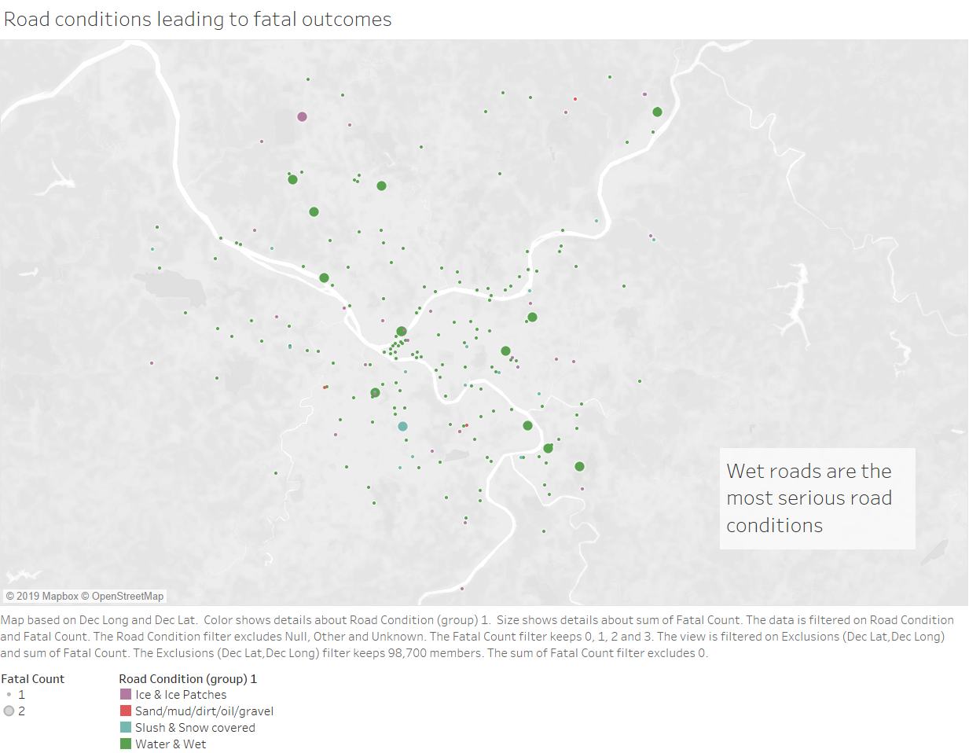
Theme 2: Environmental Variables: Road conditions
Key Finding:
Since slippery roads are one of the major factors, proper drainage systems in high risk zones must be implemented.

Slide 15
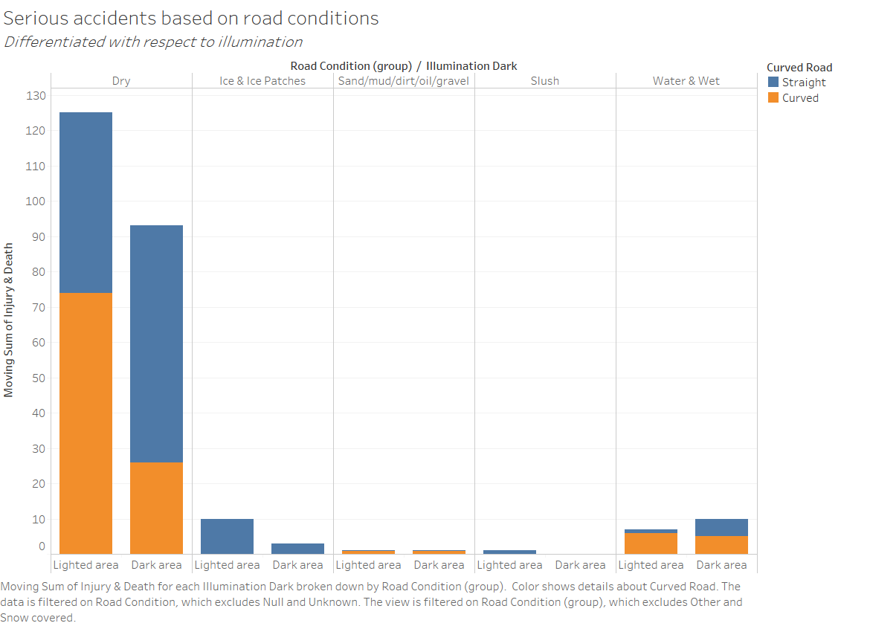
Theme 2: Environmental Variables: Road conditions
Key Finding:
Amongst all the serious accidents, curved roads account for almost half of the accidents.
Lower speed limits and reflective road signs must be put up at these locations.

Slide 16
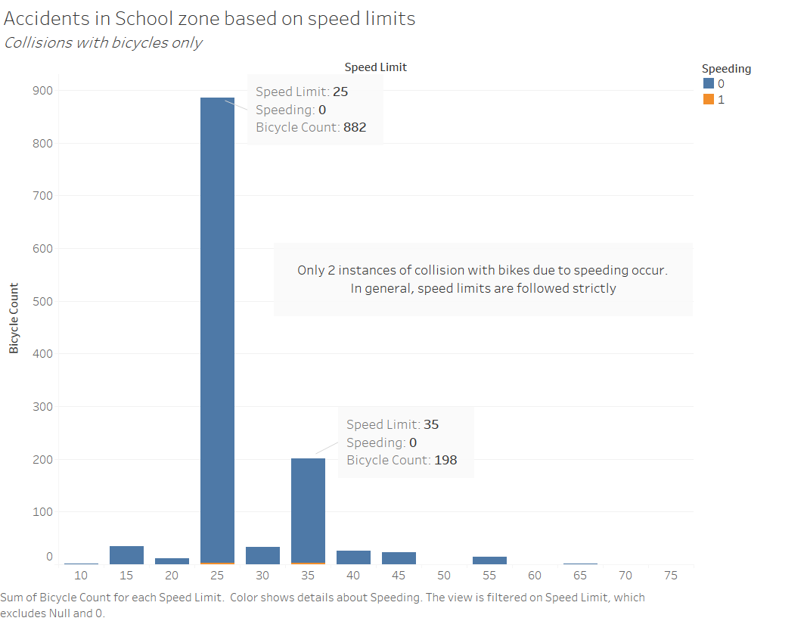
Theme 2: Environmental Variables: School Zones
Key Finding:
The implementation of strict speed norms ensures that any collisions happening aren’t at high speed
Negligible fatalities in school zones for biker accidents are observed

Slide 17
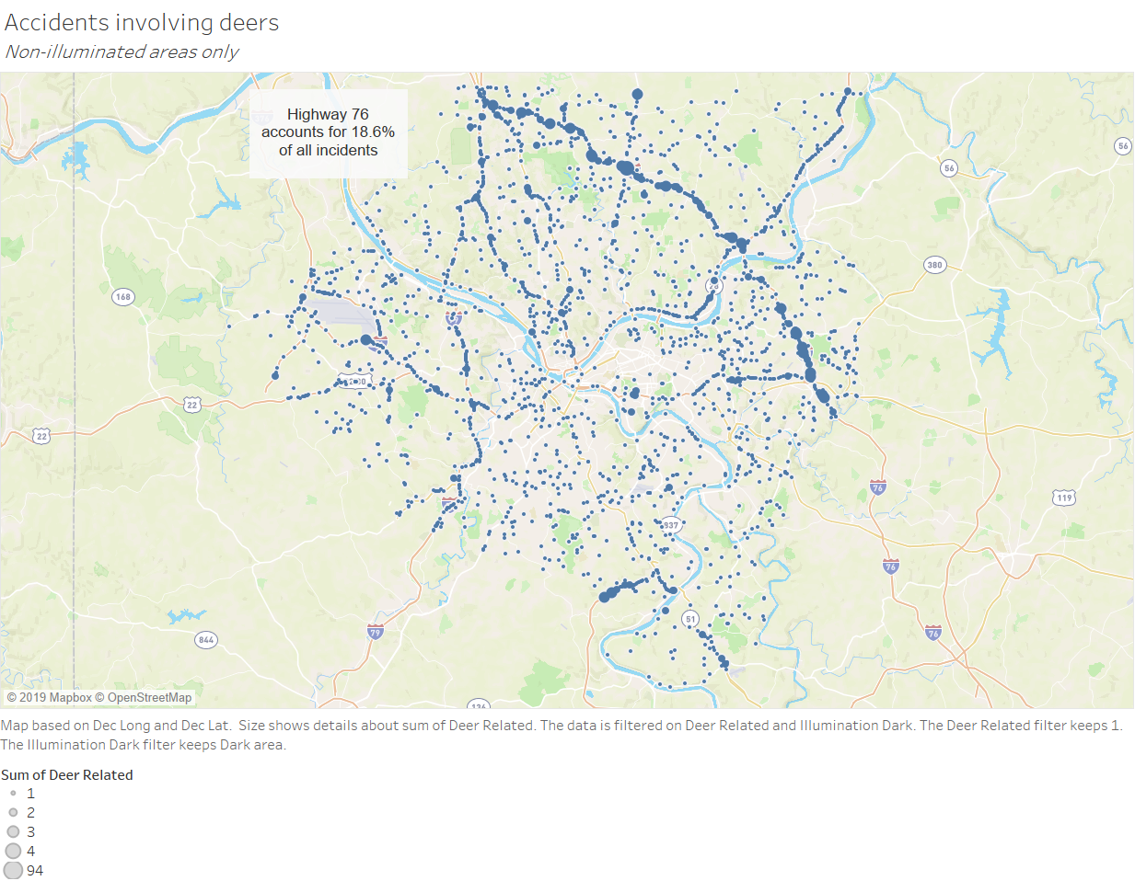
Theme 2: Environmental Variables: Deer involved
Key Finding:
There are certain areas (for instance, highway 76) which have high occurrence of accidents especially in less illuminated regions

Slide 18
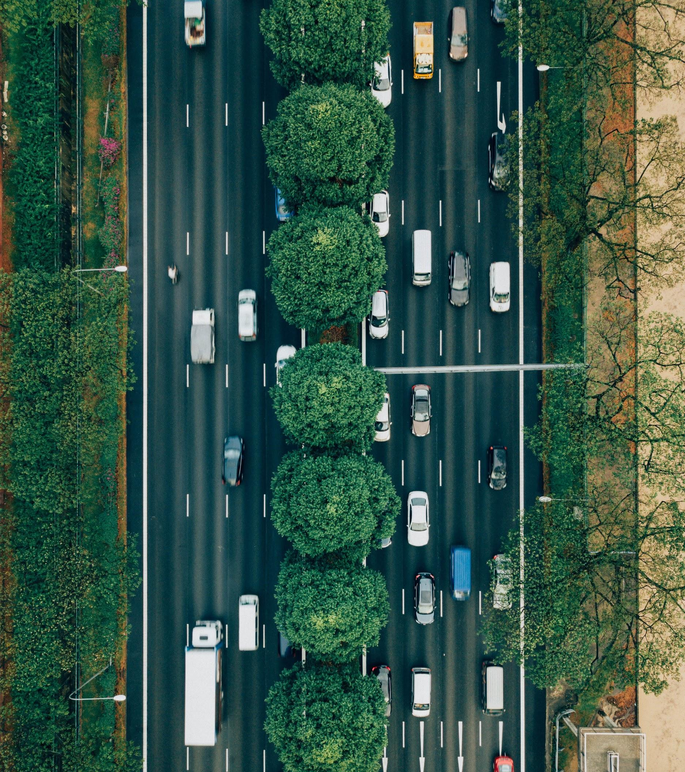
Theme 3: Driver Behavior
Aggressive Driving
Impaired Driving
Traffic Violations
Distracted Driving
Driver Age

Slide 19
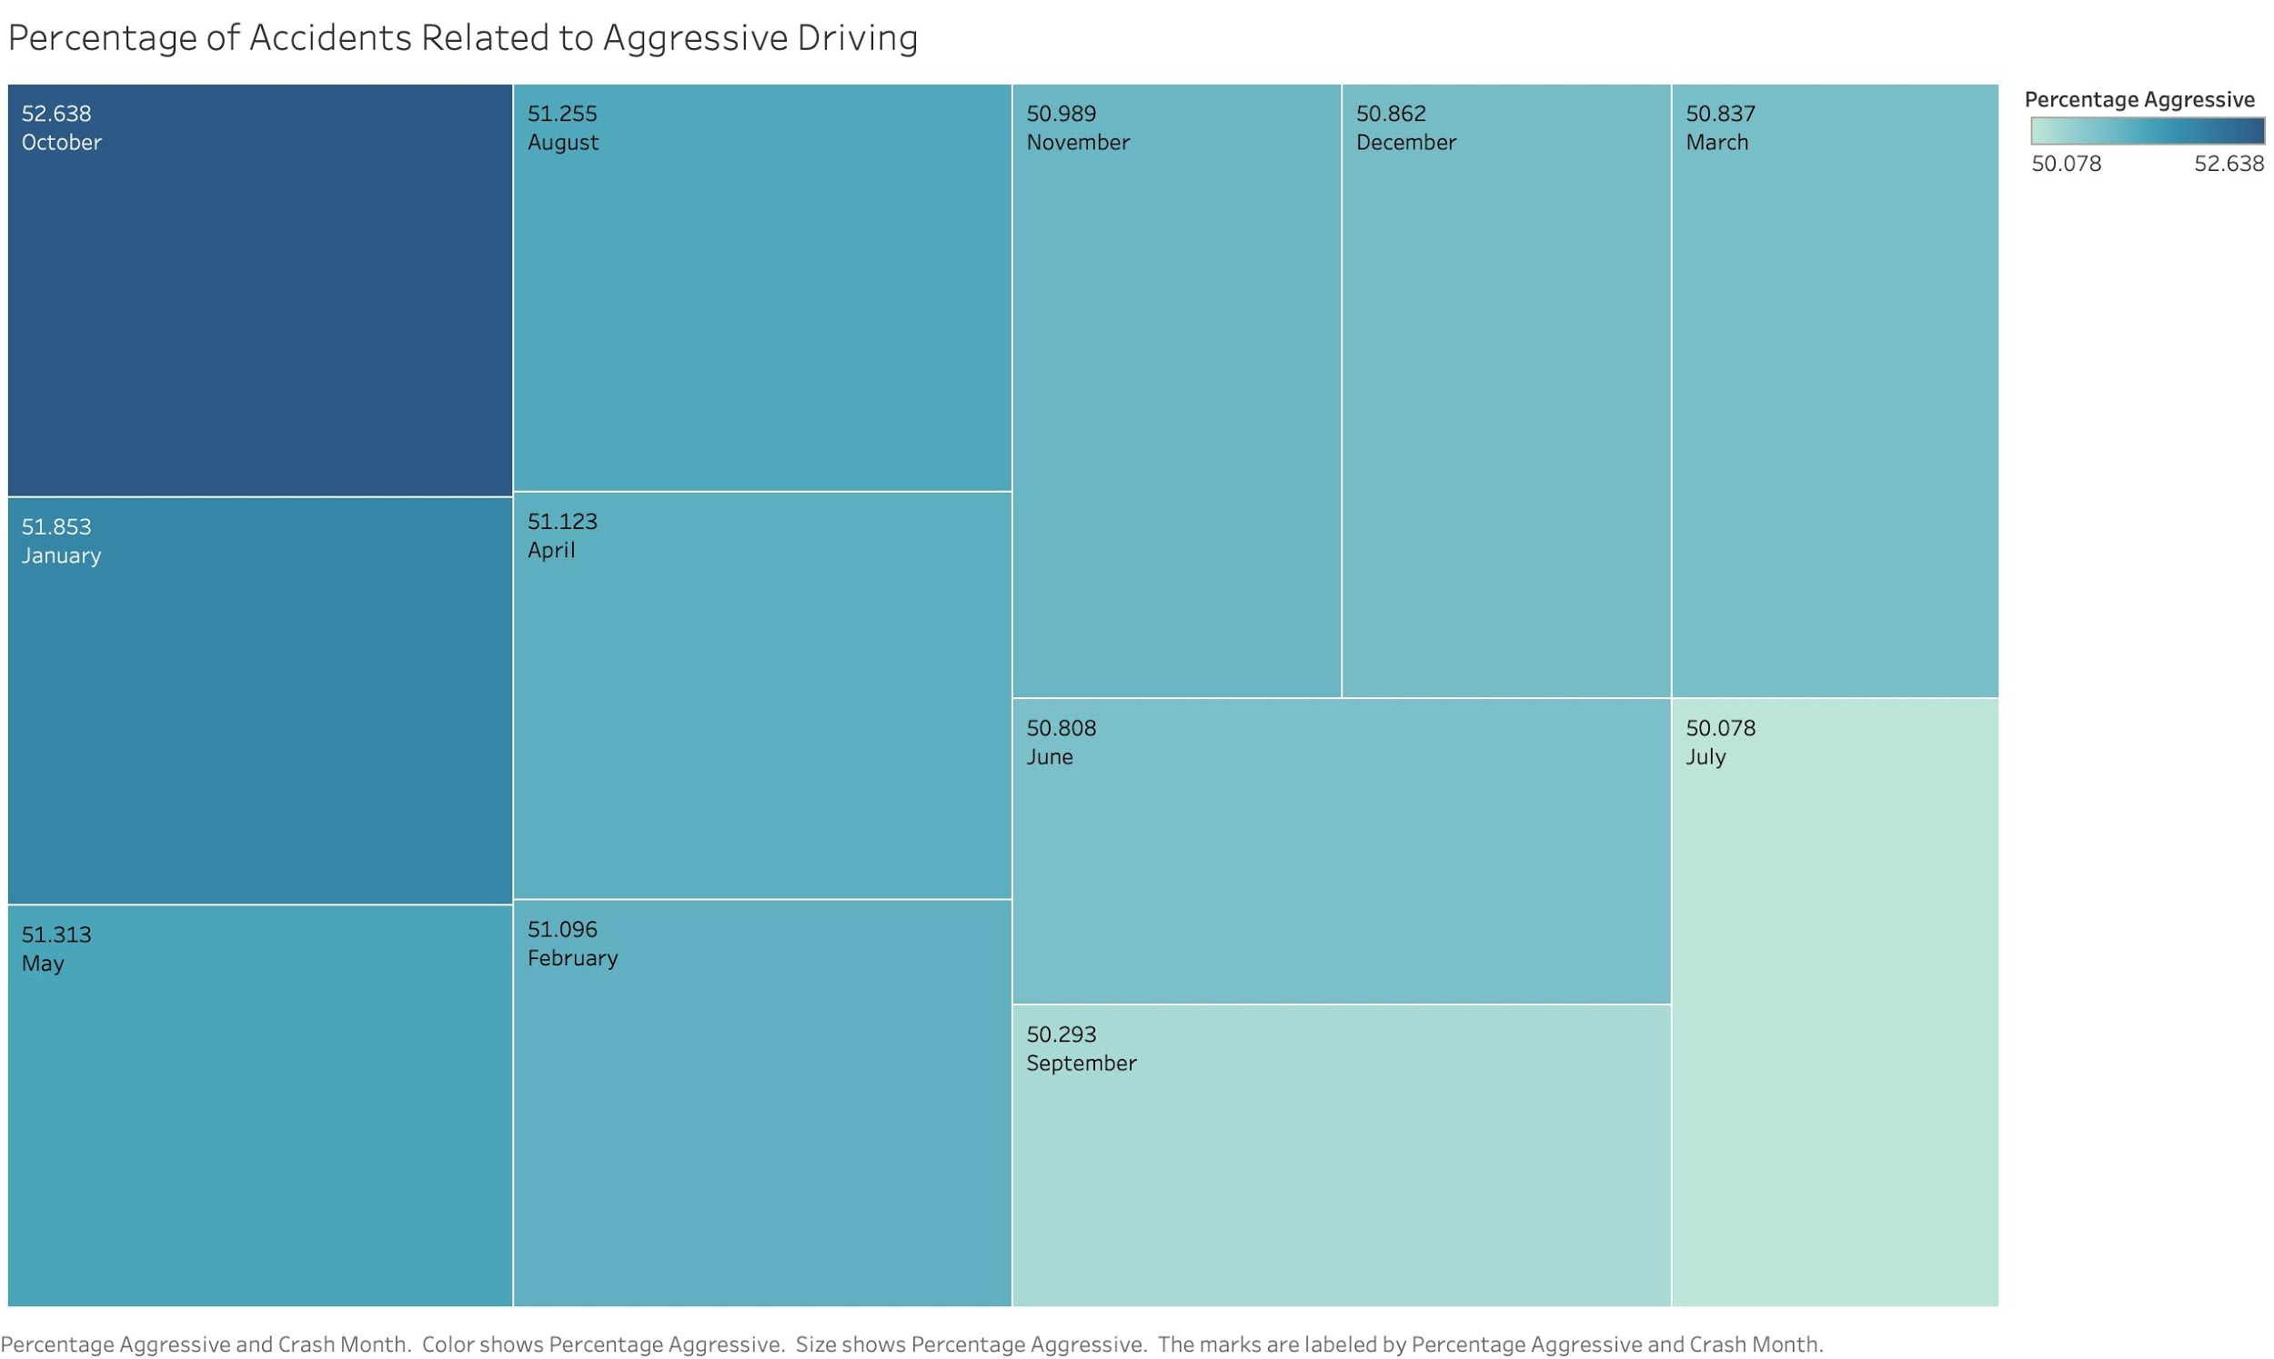
Theme 3: Driver Behavior: Aggressive Driving
Key Finding:
Across all months, at least 50% of accidents are related to aggressive driving.
Aggressive driving behavior varies slightly from month to month.

Slide 20
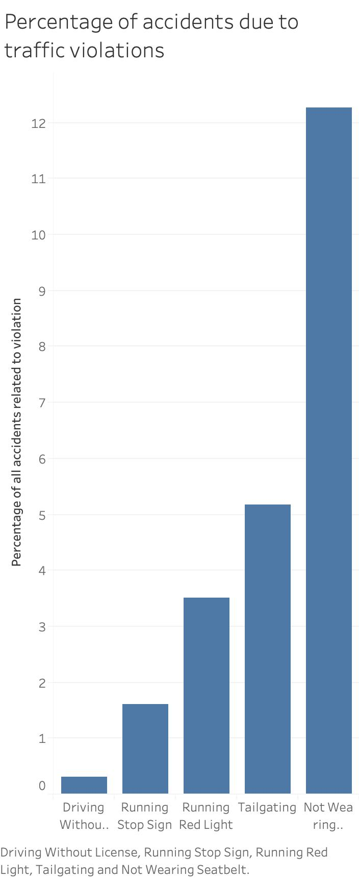
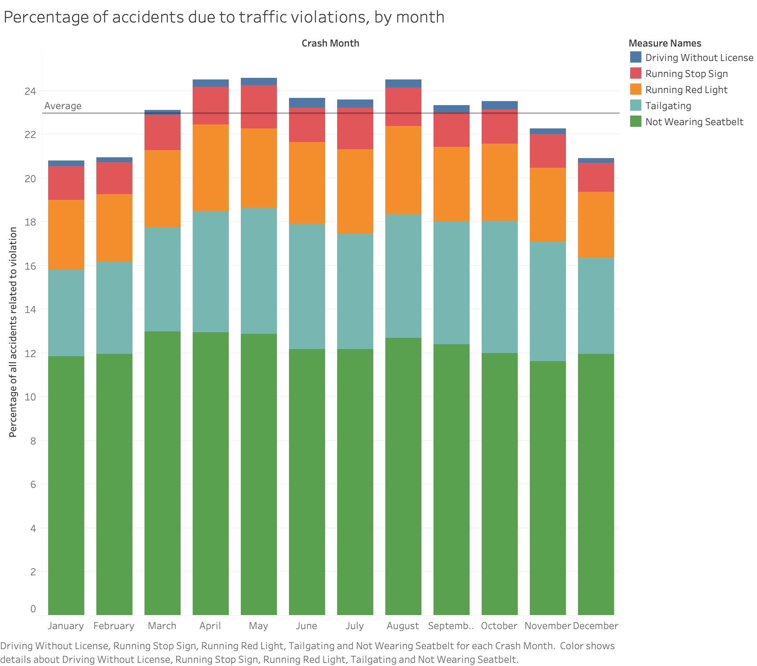
Theme 3: Driver Behavior: Traffic Violations
Key Finding:
Not wearing a seatbelt is the main traffic violation associated with accidents in our data.
There is a seasonal increase in traffic violations from March through October.

Slide 21
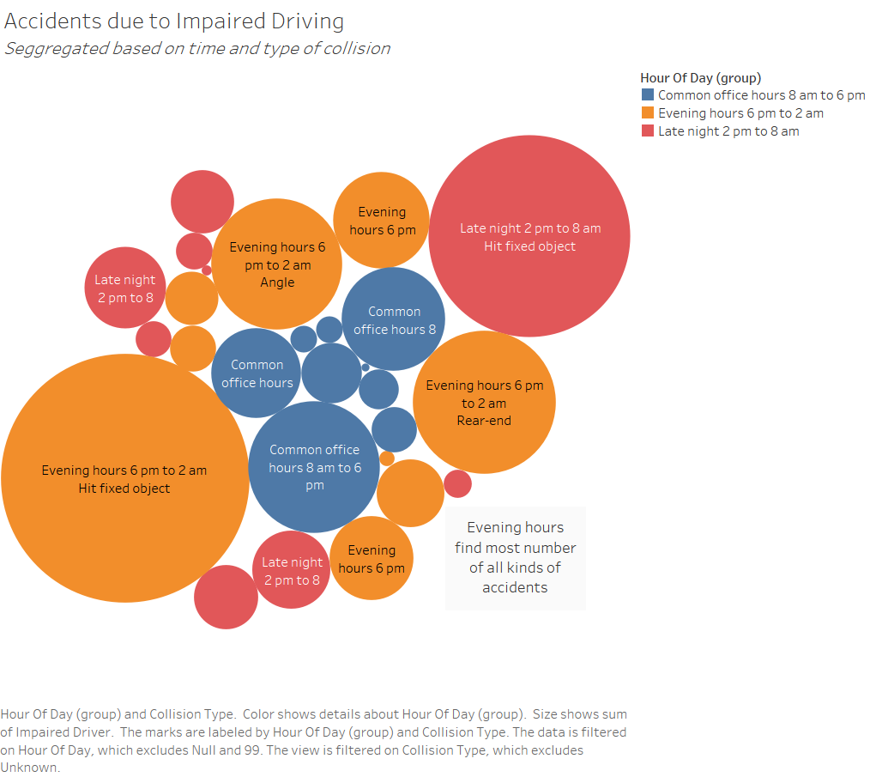
Theme 3: Driver Behavior: Impaired Driving
Key Findings:
Evening hours between 6pm to 2am witness most accidents in all categories and hence we must have expanded public safety measures including increased law enforcement presence and campaigns to encourage alternatives to impaired drive.

Slide 22
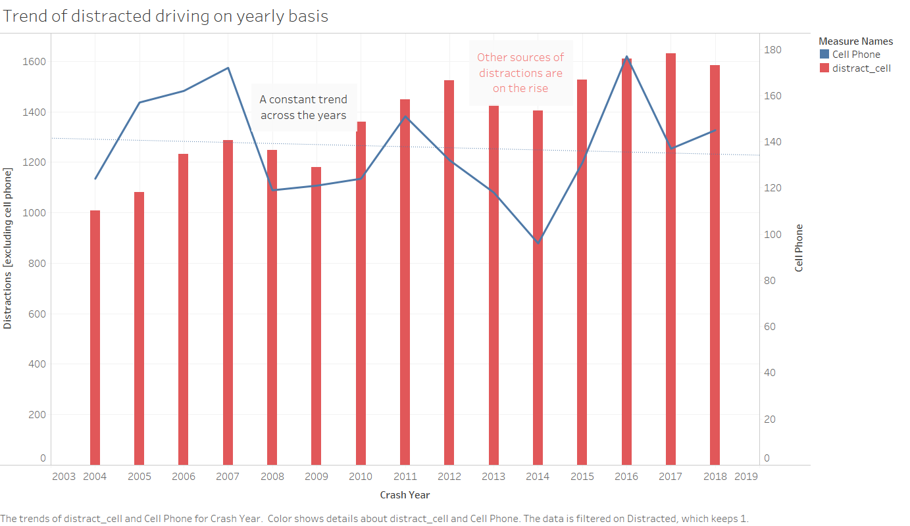
Theme 3: Driver Behavior: Distracted Driving
Key Finding:
Surprisingly, cell phone related cases have a decreasing trend
Other events are in general increasing

Slide 23
Our Recommendations
Based on our findings, we recommend the following:
Accident Facts
Interventions to reduce accidents need to be adaptable from season to season.
Environmental Variables
Illumination and road conditions must be improved to reduce accidents.
Driver Behavior
Campaigns should be launched to reduce aggressive and impaired driving.

Slide 24

Thank you!
Any questions?
Data Science and Big Data
Fall 2019
Team 8: Kanisk Mair and Brian McGrath
Sources:
Data
Images
Sources:
Data: Allegheny County/City of Pittsburgh/Western PA Data Center
https://catalog.data.gov/dataset/allegheny-county-crash-data
Images: D. Nevozhai, E. Seguin, A. Dicaterina, chuttersnap, A. Schwartz on Unsplash: https://unsplash.com

